Slide 1
Online Based Emergency Medicine And Doctor Services
Nabiha Tahsin (18201024)
Shawon Barman (18201043)
Jesmin Aktar (18201044)

Slide 2
Outline:
Introducting Emergency Medicine and Doctor Services project
Recuirement Analysis
Feasibility Analysis
Design phase (DFD, Use Case, ER, and UML class diagram)
Methodology

Slide 3
Introduction :
Remotes areas people are deprived from proper treatment facilities and during emergency situation its became very pathetic for them to collect necessary medicines.
Easiest way to get Medicine and Doctor information.
Take appointment
Health News
Order any medicine
get the essential service at home without coming to the city at low costs.
Ask health related question and get answer

Slide 4
Objective of the System :
Main purpose of this system is to provide proper medicine and medical services through online for remote area’s people.

Slide 5
Resources we need to build the system :
Money
Manpower

Slide 6
Requirement Analysis

Slide 7
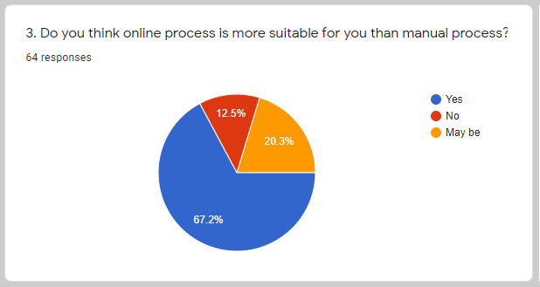
Do you think online process is more suitable for you than manual process?

Slide 8
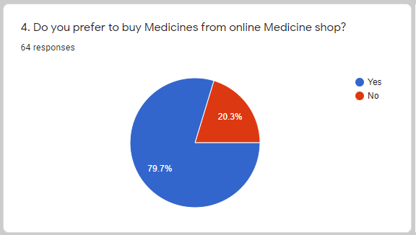
Do you prefer to buy Medicines from online Medicine shop ?

Slide 9
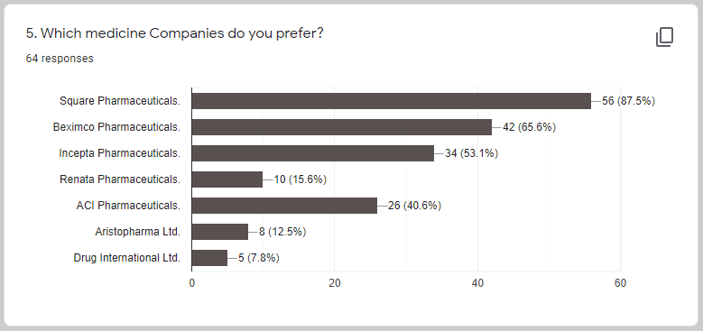
Which medicine Companies do you prefer ?

Slide 10
How long will you wait for your ordered medicines to receive?

Slide 11
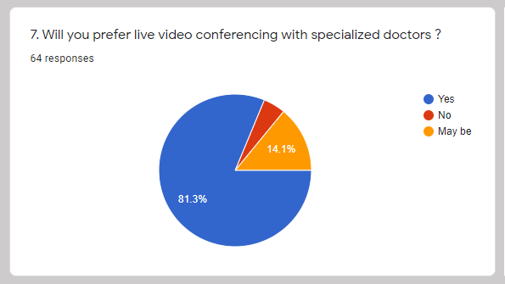
Will you prefer live video conferencing with specialized doctors ?

Slide 12
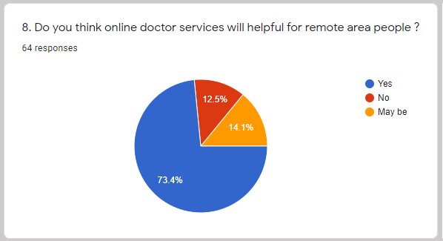
Do you think online doctor services will helpful for remote area people ?

Slide 13
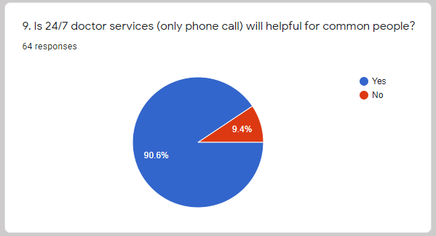
Is 24/7 doctor services (only phone call) will helpful for common people?

Slide 14
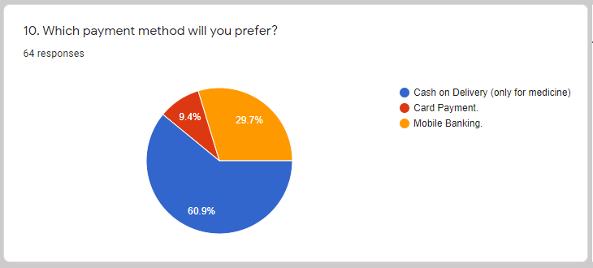
Which payment method will you prefer ?

Slide 15
Decision from Survey
Sale medicine from online medicine shop
delivery medicine within 1-2 hours
Live video conferencing or voice call conferencing with doctors
Pay bill by cash on delivery, Bkash payment, and Credit card payment.

Slide 16
Feasibility Analysis

Slide 17
About of feasibility analysis:
One of the major Phase of SDLC .
Also called decision making phase.
After the feasibility Studies-
May be accepted with some modification.
Rejected
Divided into three key components, which are
Economic feasibility
Technical feasibility
Organizational feasibility

Slide 18
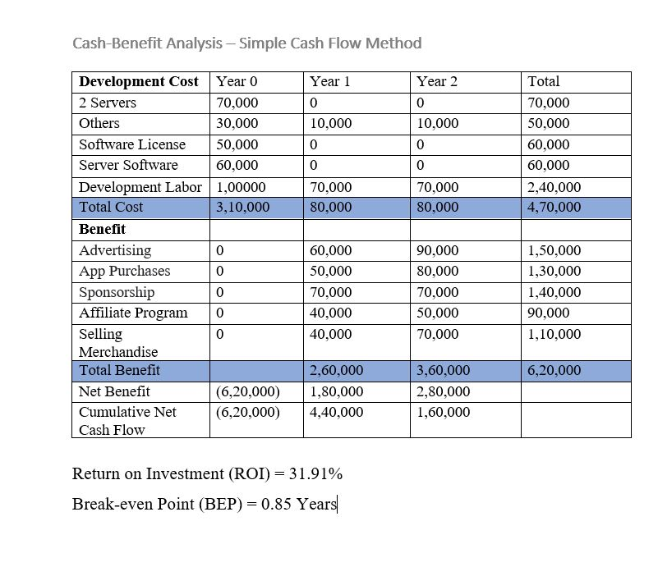
Economic Feasibility:
For our system, We will use Simple Cash Flow Method.
From, This analysis,
Acceptable ROI
Benefit starts from the First year.

Slide 19
Technical Feasibility:
A technical feasibility study assesses the details of how we intend to deliver a product or service to customers.
Source Of Risk:
Users have a lack of familiarity with our system?
Whether the treatment that doctors will give to patients will be right?
Will user data safe with us?
Our system will give medicines to users will be original?

Slide 20
Organizational Feasibility:
Organizational feasibility shows that how well the system ultimately will be accepted by its users and incorporated into the ongoing operations of the organization.
If we will build it will they come?
Our system will be one of the most efficient system available on the market.
People from remote areas will be able to get the essential service at home without coming to the city at low costs.

Slide 21
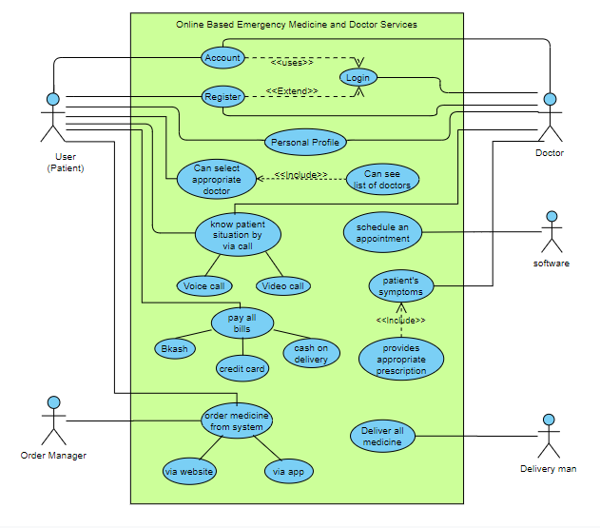
Use Case Diagram

Slide 22
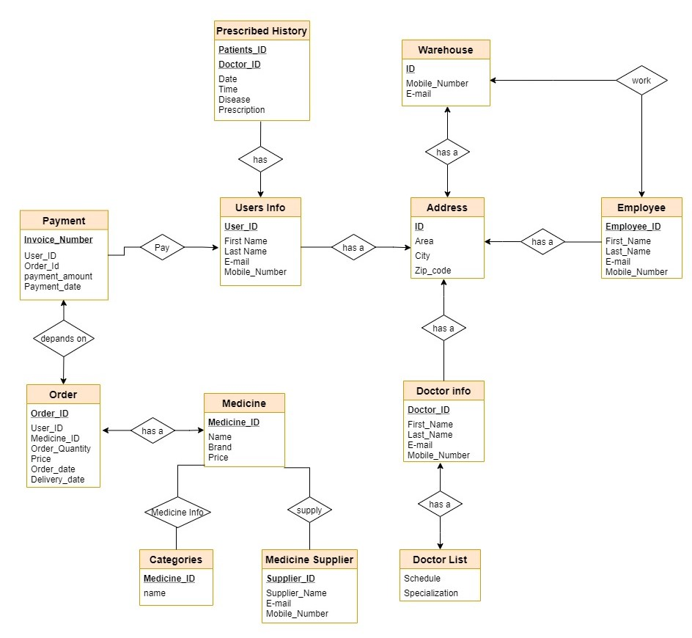
ER Diagram

Slide 23
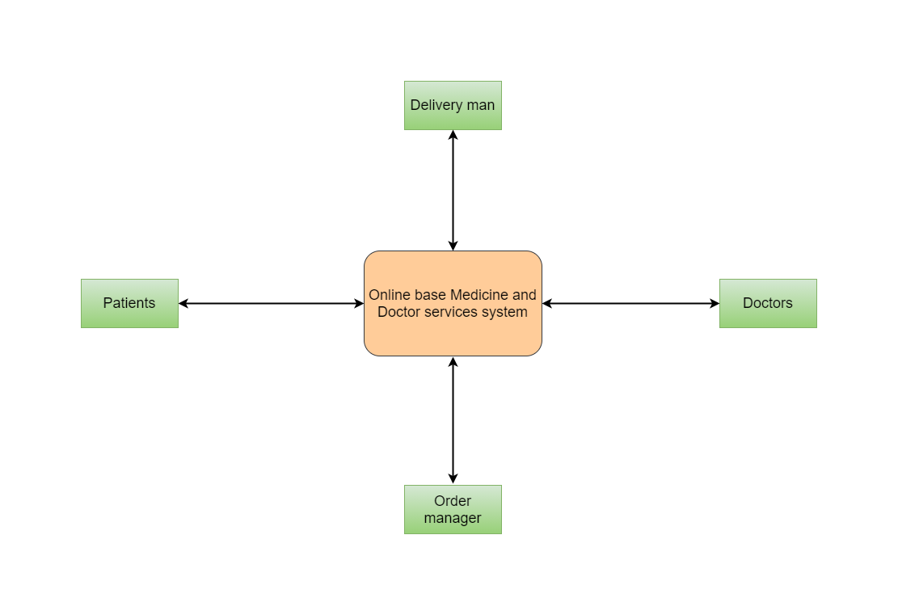
Data Flow Diagram Level 0

Slide 24
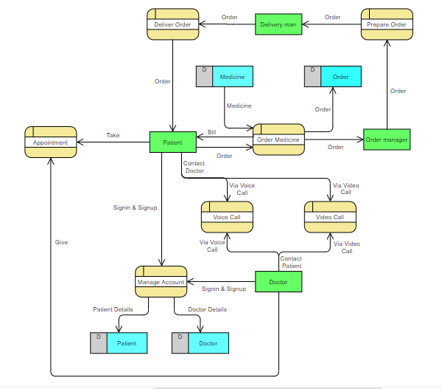
Data Flow Diagram Level 1

Slide 25
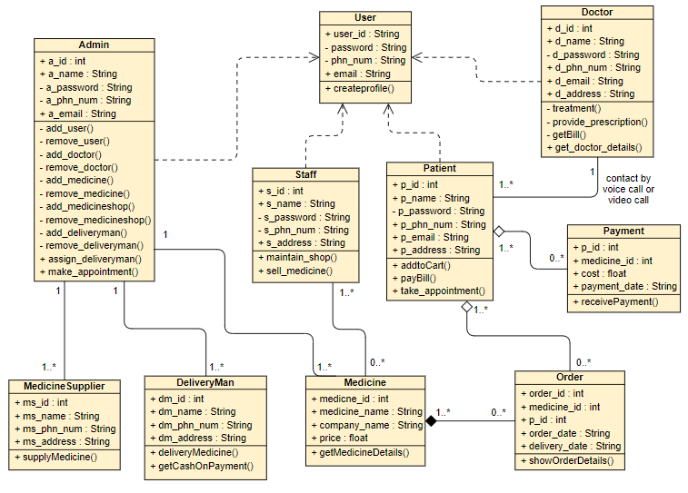
UML Class Diagram

Slide 26
Methodology
what is methodology?
Methodology resources
Internally developed by the organization
Consulting
Software vendors
Government agents
Now lets have a look at some methodologies
Waterfall Methodology
Parallel Methodology
V-model Methodology
Iterative Methodology
System Prototyping Methodology
Agile Development Methodology

Slide 27
Which Methodology is best for develop our system?
Waterfall Methodology
Recuirement Analysis
System Design
Implementation
Testing
Deployment
Maintenance

Slide 28
Thank You

